Slide 1
Computer Graphics Change of Basis
László Szécsi szecsi@iit.bme.hu
AIT

Slide 2
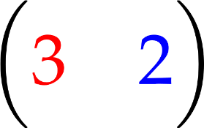




Our coordinate system

Slide 3
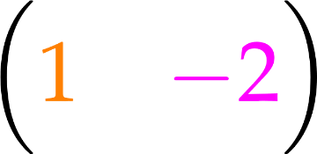
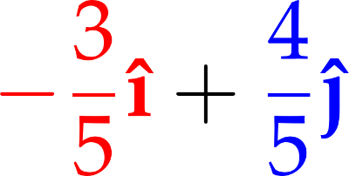
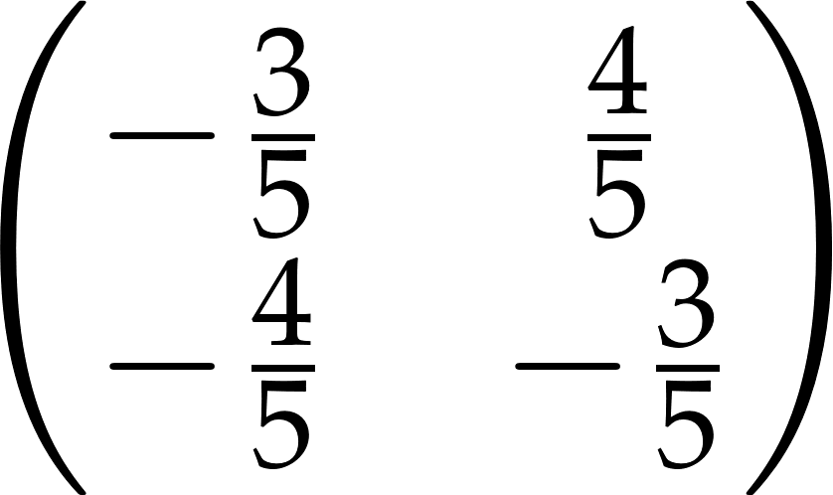
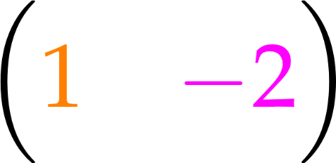
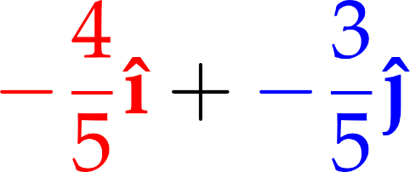
Tom's coordinate system
Tom says
orange is
purple is

Slide 4

Notes:
What is the matrix?

Slide 5
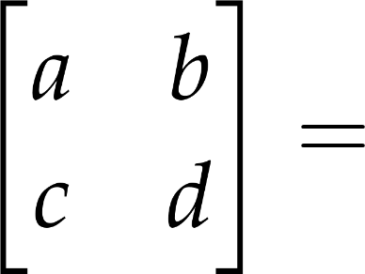
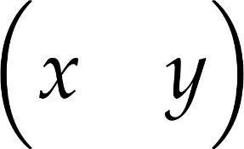






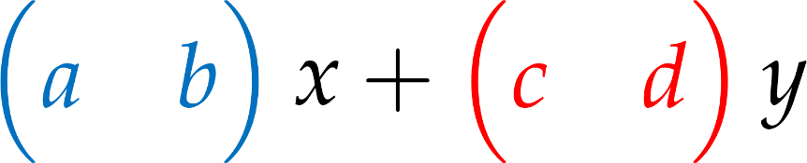
Vector-matrix multiplication

Slide 6
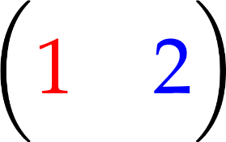
What if we use Tom's coordinates and our coordinates in the same system?

Slide 7
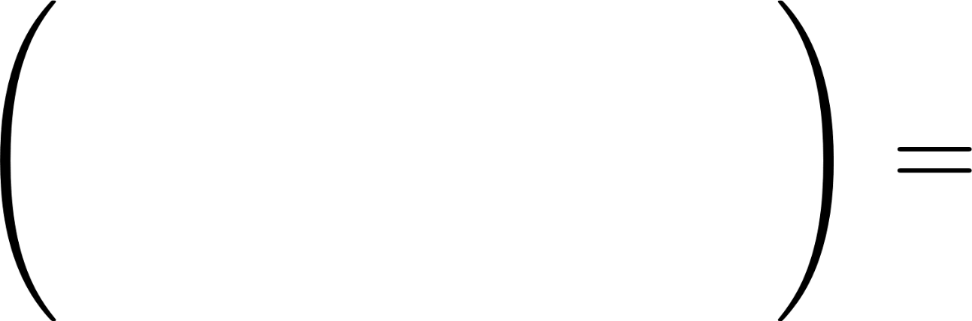
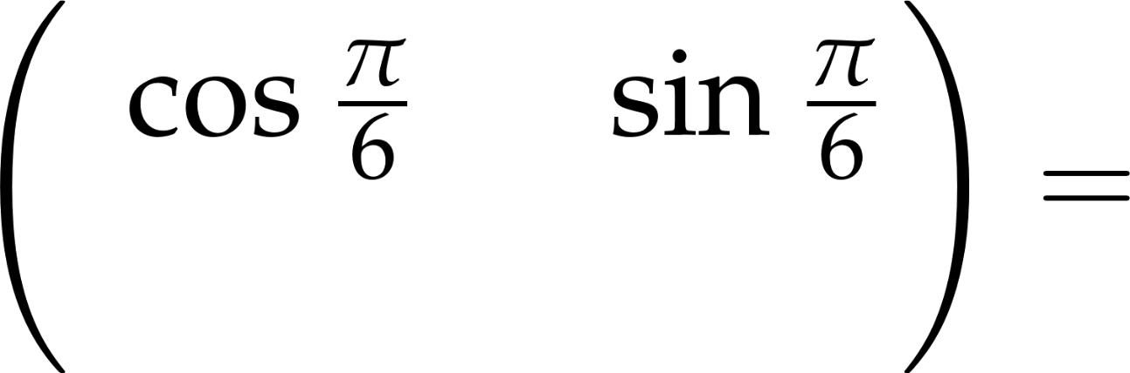
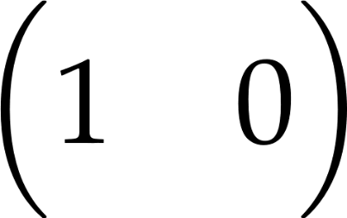
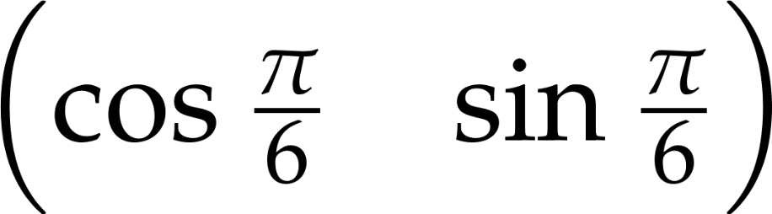
How do we rotate by π/6 instead?
what to write here?
Tom's original
our rotated version

Slide 8
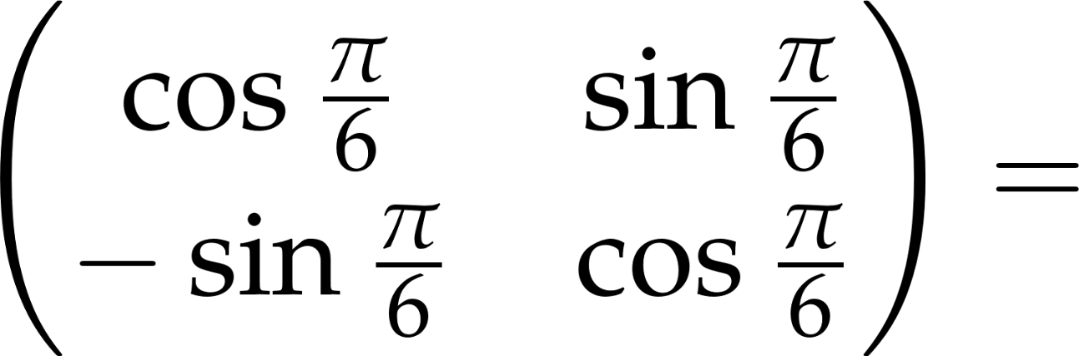
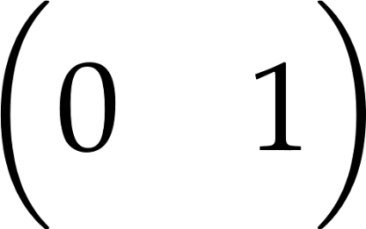
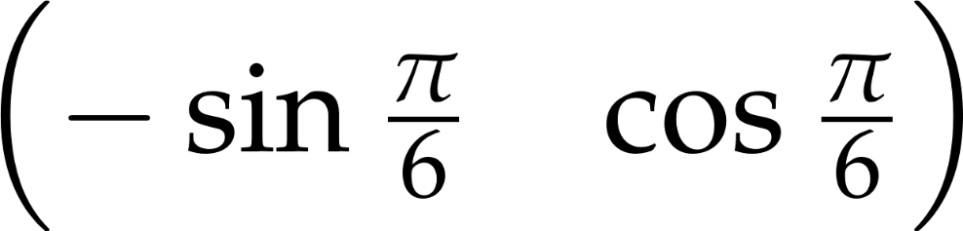
How do we rotate by π/6 instead?
what to write here?
Tom's original
our rotated version

Slide 9
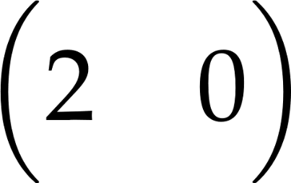
How do we scale by (2, -3)?
what to write here?
Tom's original
our rotated version

Slide 10
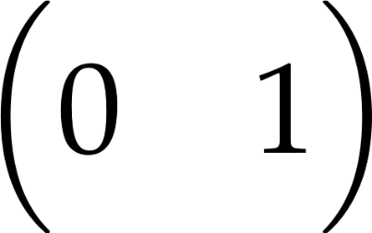
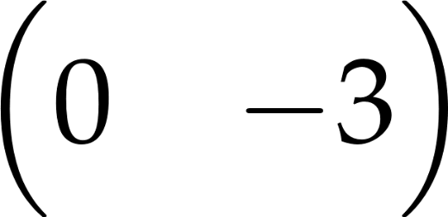
How do we scale by (2, -3)?
what to write here?
Tom's original
our rotated version

Slide 11
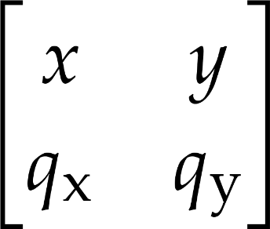


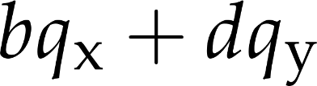
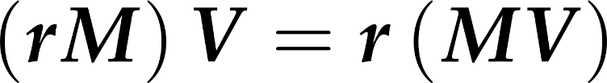
Matrix-matrix multiplication

Slide 12
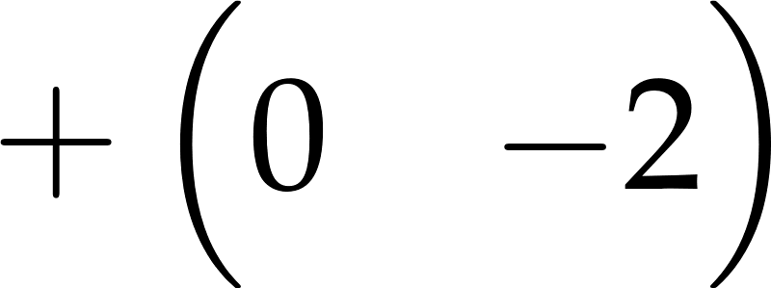

Tom is now using a different origin, too!?
Tom says
orange is
purple is
my origin is at your
origin translated by

Slide 13
What if we use Tom's coordinates and our coordinates in the same system?

Slide 14


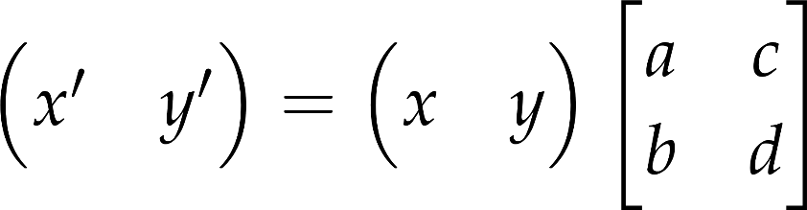
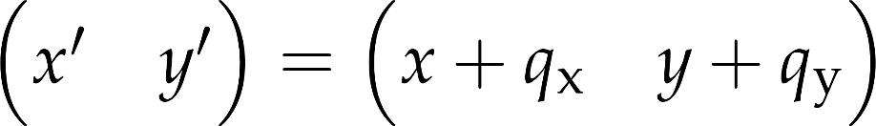
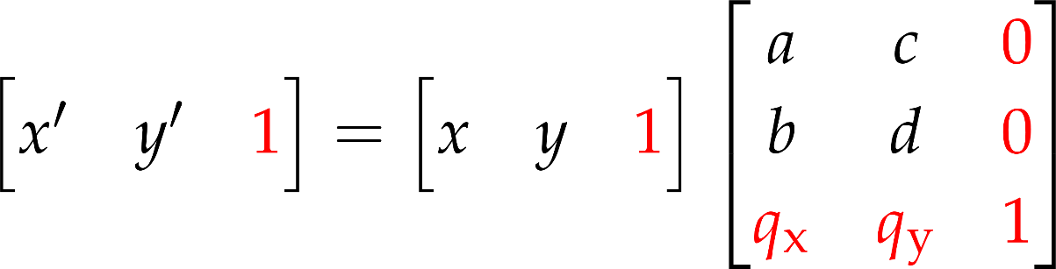
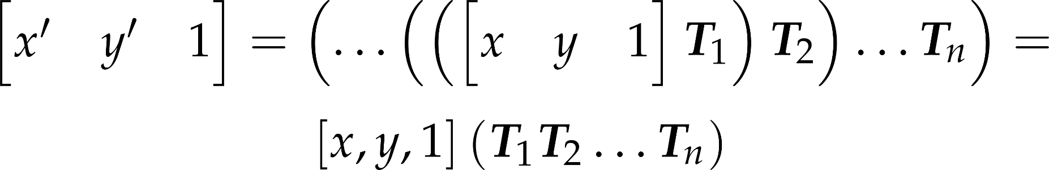
Affine transformations
Translation:
Others:
Let us put both linear transformations and translation into a matrix
Notes:
So far, we have seen simple transformations that indeed map parallel lines to parallel lines, thus are affine. With the exception of the translation, all of them could be expressed as a multiplication with a 2x2 matrix.
To handle translation similarly to other affine transformations, i.e. with matrix multiplication, we should increase the size of the matrix from 2x2 to 3x3 in 2D. Simultaneously, the vector should also be extended by a third coordinate to allow the multiplication with a 3x3 matrix. Formally, we add a row of the translation vector to the 2x2 matrix, and a column that contains 0, 0, 1, while extend the vector by a constant 1. In this way, it is guaranteed that the third 1 value is preserved for arbitrary x, y. This representation contains all previous transformations, for example in case of translation a=d=1, b=c=0 and px, py are the translation vector.
Why are we trying to handle all affine transformations (including translation) uniformly with a matrix multiplication? The advantages become clear when we consider a series of transformations, T1, T2, etc. This means that first T1 is applied, then its result is transformed further by T2, etc. As matrix multiplication is associative, an arbitrary long transformation sequence can be expressed by a SINGLE vector-matrix multiplication, where the matrix is the product of elementary transformation matrices.
Why is this good for us? In practice we have very many (say one million) points that go through many (say 10) transformations.
If we applied transformations one by one, we should execute 10 million vector-matrix multiplications.
However, if we concatenate matrices first, which requires 10 matrix-matrix multiplications, then the same result could be obtained with only 1 million vector-matrix multiplications. Almost ten times speed up!!!

Slide 15
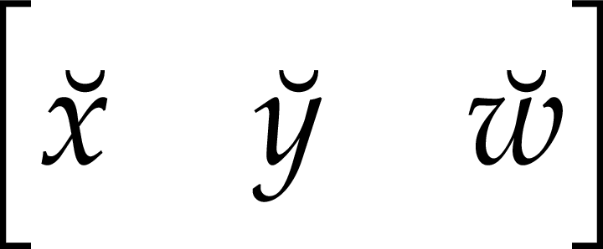

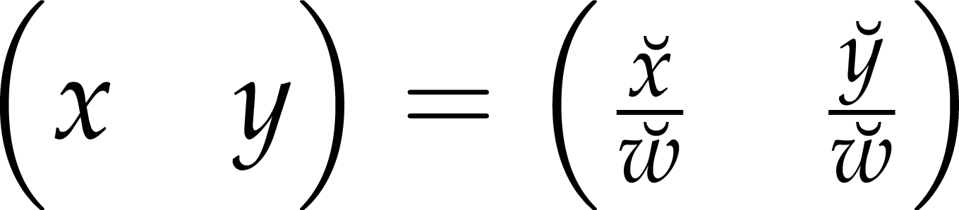
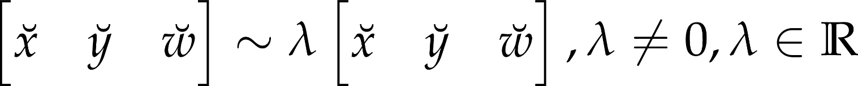
Homogeneous coordinates
let us use coordinate triplets to identify 2D points
breves (horns) to differentiate from Cartesian coordinates
works as an inverse scaler
Cartesian coordinates are obtained by division
homogeneous coordinates scaled correspond to the same point

Slide 16


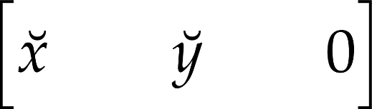
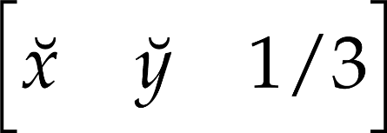
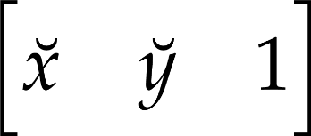
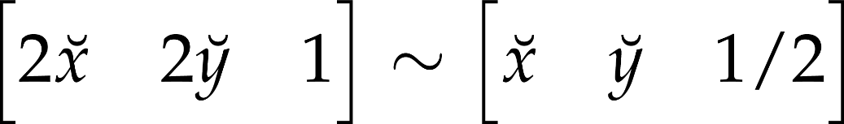

Homogeneous coordinates for points at infinity:
ideal point
Euclidean space + ideal points = projective space
Notes:
Homogeneous coordinates [x, y, h] can also be interpreted in the following way: (x, y) specify the direction of the point, and 1/w is a scaling of the distance.
Let us consider a point of Cartesian coordinates x,y, which can be given in homogeneous coordinates as [x,y,1].
Now, let us consider another point that is in the same direction, but twice as far as (x,y). This farther point is (2x,2y) in Cartesian coordinates, [2x,2y,1] in homogeneous coordinates, or [x,y,1/2] in homogeneous coordinates. Similarly, the point that is also the same direction but is f times farther away is [x,y,1/f]. So the interpretation of a homogeneous triplet is that the first two coordinates are Cartesian ones and show the direction, and the third coordinate is an inverse scaling of the distance. When f is infinity, so 1/f is zero, then we get [x,y,0], which is at the direction of (x,y), but at infinity.
With homogeneous coordinates we can express ideal points, i.e. points at infinity that are the intersections of parallel lines. Note that in Euclidean geometry parallel lines do not intersect. So, when we work with homogeneous coordinates instead of Cartesian ones, we describe the projective plane that contains the ideal points as well, and not the Euclidean plane.

Slide 17
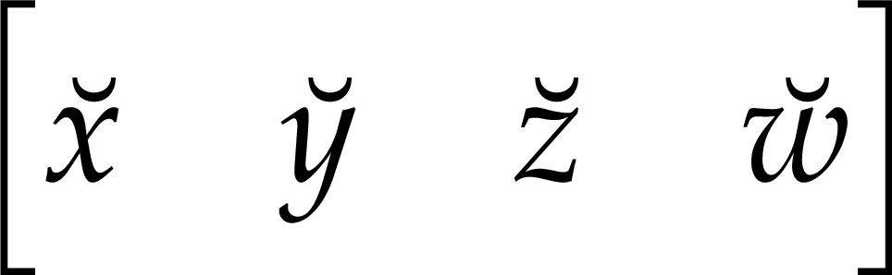
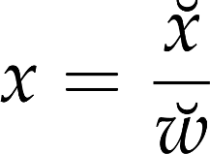
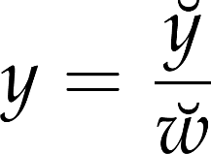
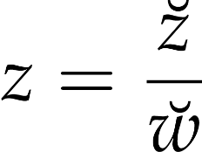
Homogeneous coordinates (3D)
All cannot be simultaneously zero
Notes:
3D points can also be represented with homogeneous coordinates, i.e. the 3D Cartesian space can also be extended to 3D projective space.

Slide 18
Computer Graphics Transformations
László Szécsi szecsi@iit.bme.hu
AIT

Slide 19
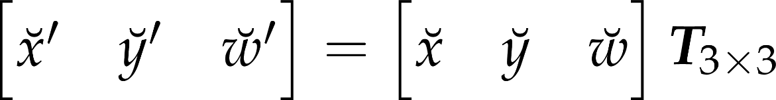
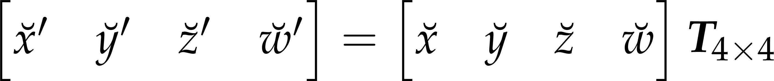
Homogeneous linear transformations
Multiplication of the vector of homogeneous coordinates with a transformation matrix
We prefer row vectors for points (matter of taste)
2D transformation is a 3x3 matrix
3D transformation is a 4x4 matrix
Notes:
Homogeneous linear transformations are the multiplications of the vector of homogeneous coordinates by a matrix. The vector can be a row vector when it is on the left side of the matrix. On the other hand, the vector can also be a column vector, and stands on the right side. The two approaches are similar, just the matrix should be transposed accordingly. We shall prefer the case when the vector is a row vector, because it is more intuitive when multiple transformations are executed on after the other.
A 2D point is described by 3 homogeneous coordinates, thus the transformation matrix is of 3x3 size.
For 3D points, the matrix has 4x4 elements.

Slide 20
Transformation concatenation
Matrix multiplication is associative!
If points are row vectors, the order of matrices in the product is the same as the order of transformations.
Notes:
In practice we execute not only a single transformation, but a sequence of transformations. This can be imagined as transforming the point with T1, then the result by T2, etc. However, as matrix multiplication is associative, i.e. parentheses can be regrouped, we obtain the same result if we multiply the point with the product of concatenation of the transformation matrices. Any sequence of transformations can be expressed as a single matrix multiplication. If we consider points as row vectors, then the order of transformation matrices will correspond to the order of their execution.

Slide 21

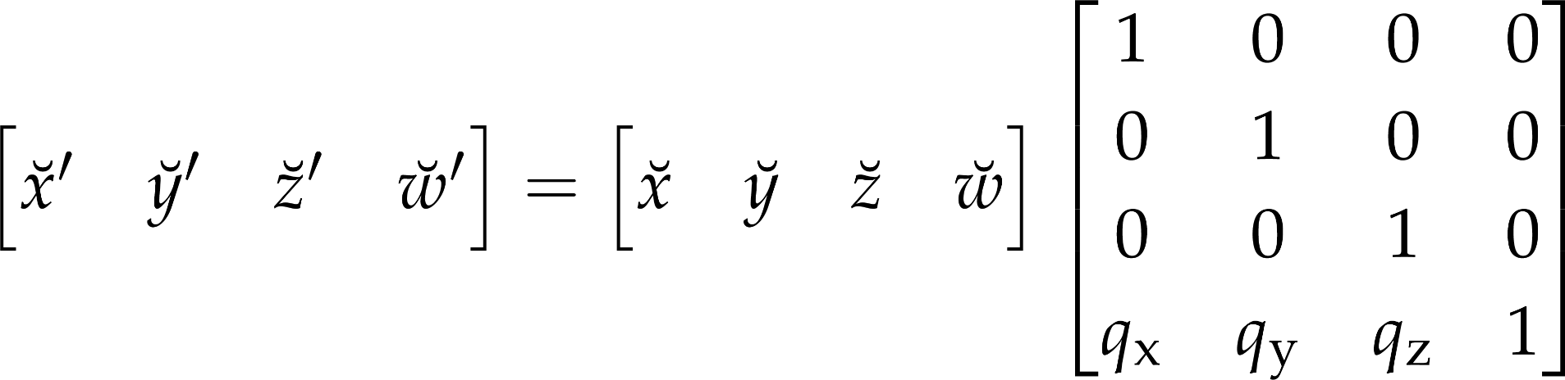
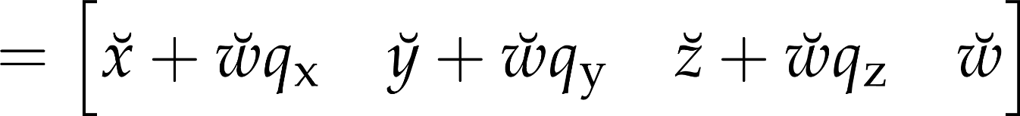
Translation
const m =
new Mat4().translate(qx, qy, qz);
Notes:
The first elementary transformation considered is the 3D translation. This transformation computes the sum of the Cartesian coordinates of the point and of the translation vector p. This operation can be represented by a homogeneous transformation matrix, where the diagonal elements are 1, the last row contains the translation vector and all other elements are zero.

Slide 22
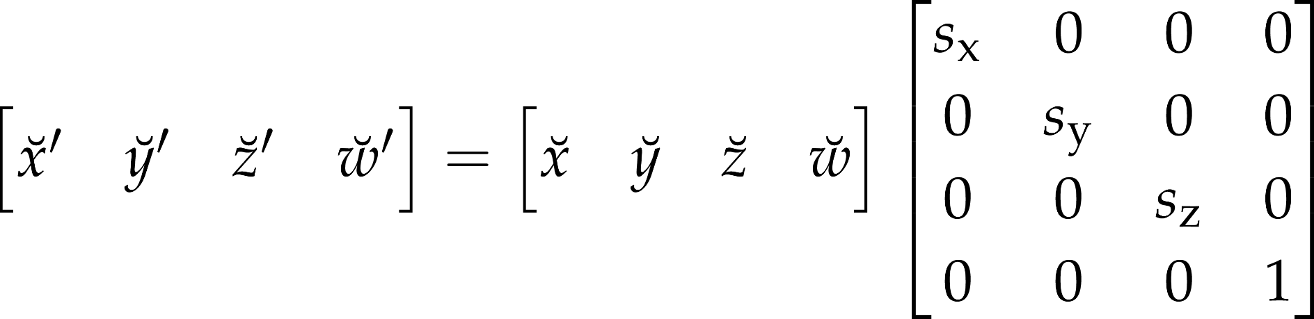
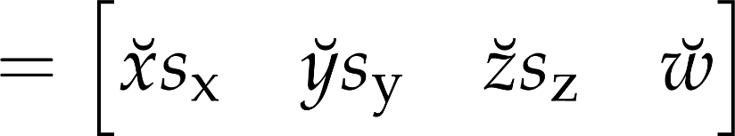
Scaling
let m =
new Mat4().scale(sx, sy, sz);
Notes:
The second transformation is scaling along the coordinate axes. This scales x coordinates by Sx, y coordinates by Sy and z coordinates by Sz. Scaling is a diagonal homogeneous linear transformaiton, including the scaling factors and 1 in the diagonal.

Slide 23
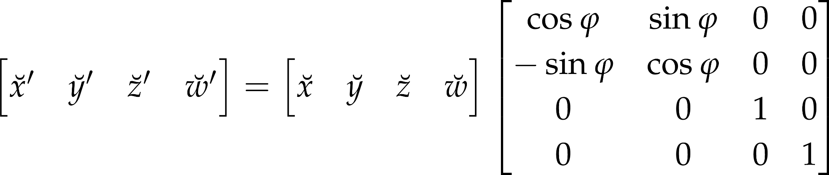
Rotation around axis z
let m =
new Mat4().rotate(phi);
phi in radians!
Notes:
Rotation, for example around axis z, is a congruence transformation, thus it surely belongs to the category of homogenous linear transformations.
If we rotate around axis z, coordinate z is left unchanged and x, y are modified. Let us express x, y with polar coordinates r, alpha. Rotation does not modify r, but the polar angle is increased by the rotation algle phi.
Using trigonometric identities, we can express the transformed point’s x’, y’ coordinates, which indeed can be realized by a matrix multiplication.

Slide 24

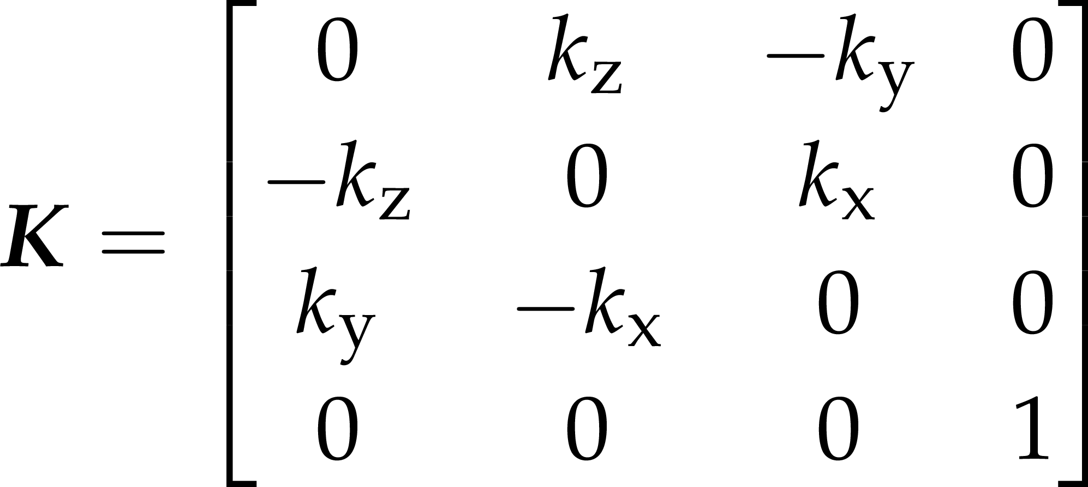

Rotation around an arbitrary axis
let m =
new Mat4().rotate(phi, kx, ky, kz);
phi in radians!
Notes:
Rotation around an arbitrary axis can also be performed by matrix multiplication, but the formula (known as Rodriguez’s rotation formula) is not as self-evident as some previous transformation examples, but certainly does not lack elegance. It can be derived using the same tools we have been using: separating the position vector into an axis-parallel and an axis-perpendicular part, and writing the trigonometry for the rotations. While all steps are fairly simple, the derivation is quite tedious, so we skip it here. For all our practical purposes, we only need to know that the matrix class’ rotation or rotate method assembles this matrix for us.

Slide 25
Transforming vertex shader
.
instead of
uniform struct { vec3 position } gameObject;, we use
uniform struct { mat4 modelMatrix; } gameObject;
instead of adding gameObject.position, we
multiply vertexPosition with gameObject.modelMatrix from the right
set the result to gl_Position
also pass on color
When drawing multiple objects, their positions and orientations will differ. Every object will have its own modelMatrix. We have to set it for every object before it is drawn. The struct name gameObject reflects this.

Slide 26
On the JS side
!
create a translation matrix using avatarPosition and pass it to the uniform
const modelMatrixHandle = gl.getUniformLocation(
this.solidProgram.glProgram, "gameObject.modelMatrix");
if(modelMatrixHandle == null) {
console.log("Could not find uniform gameObject.modelMatrix.");
} else {
const modelMatrix = new Mat4().translate(this.avatarPosition);
modelMatrix.commit(gl, modelMatrixHandle);
}
creates identity matrix
multiplies a translation matrix to it
Tip: get rid of code you may have for setting uniforms avatarPosition, avatarScale, to avoid clutter. Now we have this more generic method to do any transformation, including scaling and even rotation.

Slide 27
Transformation exercise
!
Use a scaling in the model matrix to make avatar smaller
Mat4 has method scale
multiplies, from the right, a scaling matrix to the Mat4 object, changing its value
it takes 3 numbers, or a Vec3, or a Vec2, as parameter
insert a rotation into the model matrix
method rotate rotates around z (takes radians)
works like translate or scale, appending to existing transformation

Slide 28
Animation with transformations
!
make the avatar rotate continuously
let the user rotate the triangle by holding down some keys

Slide 29
Transformation hierarchies
!
let the avatar be controlled by the user
change translation, rotation with keys
(proper game physics will come before the spring break)
a number of other objects orbit the one controlled by the user
chain up: rotate&translate to orientation&position relative to avatar, then rotate around origin, then rotate&translate by avatar’s orient/pos

